Slide 1

Exploring Global Happiness: Insights from the World Happiness Report
Arfan, Nev, Shavez, Sophie

Slide 2


Research Question:
"What were the pivotal factors shaping societal well-being between 2015 and 2020, and how did these factors evolve in response to the unique challenges posed by the COVID-19 pandemic in 2020?"
Notes:
Our project aims to delve into the multifaceted factors that influence happiness worldwide, considering economic, social, cultural, and population indicators. To achieve this, we will conduct an exploratory data analysis (EDA) using the available data and leveraging APIs, such as Geocoding.
Our data sources were Kaggle. 7 CSV files, one for each year between 2015-2020 and one CSV file for covid outcomes in 2020.

Slide 3

How has the Happiness Score changed over the years?

Slide 4
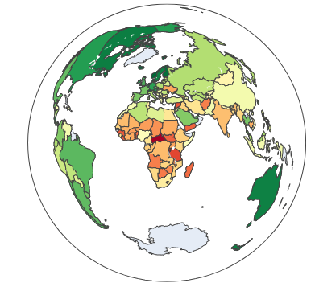
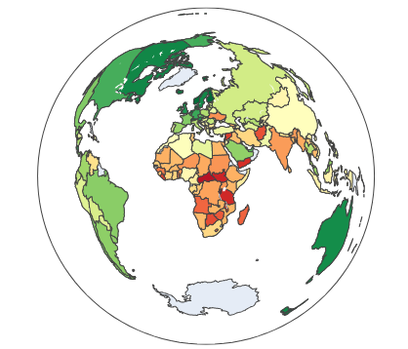
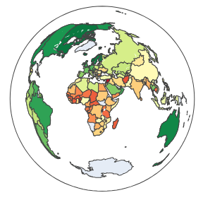
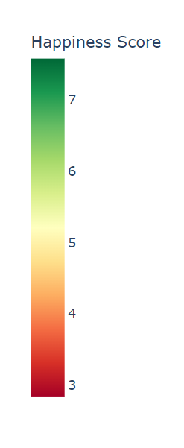
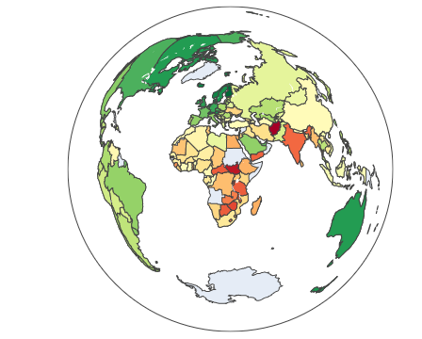
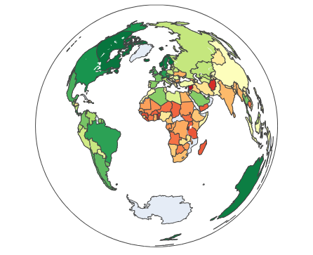
2015
2016
2017
2018
2019
2020
Notes:
Analyzing happiness scores regionally and across continents over the years reveals interesting trends. The color spectrum, ranging from green (indicating higher happiness) to red (representing lower happiness), highlights notable patterns.
Consistent Happiness in certain regions: Consistently high happiness scores are observed in North America, South America, Australia, and Europe. These regions often have stable economies, strong social support systems, and high levels of personal freedom, all of which are associated with higher levels of happiness.
Challenges in African and War-Affected Countries: The presence of red and orange shades in the African continent, particularly in the central belt, aligns with the challenges many African countries face, including issues related to political instability, poverty, and limited access to healthcare and education. Additionally, conflict zones like Syria, Afghanistan, and Iraq have experienced significant declines in happiness due to the impact of wars and violence on the well-being of their populations.
Variations in Asia: South Asia generally scores lower than its Southeast Asian counterparts, while Eastern Asia maintains a steady average happiness score of around 5, which may reflect the influence of cultural and societal norms.
Regional trends in Europe: In Europe, Western European countries consistently score high in happiness, thanks to robust economies and social safety nets. Central and Eastern European nations have made progress since the end of the Cold War, though some, like Ukraine, Bulgaria, and Georgia, still report scores averaging between 4 and 5.

Slide 5
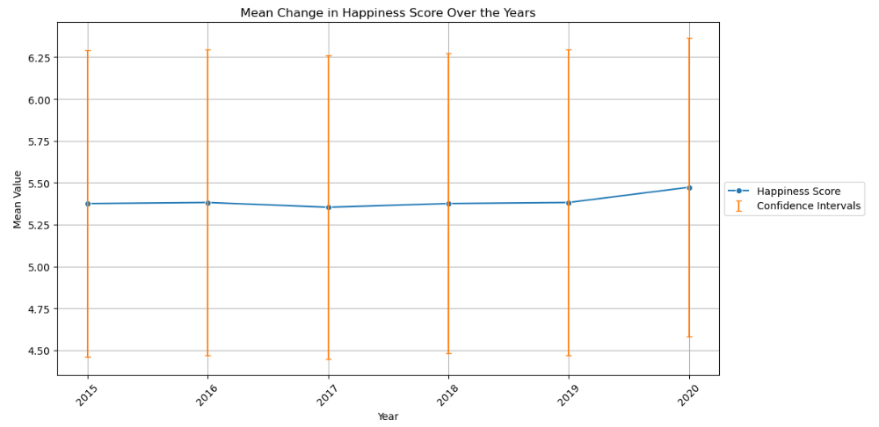
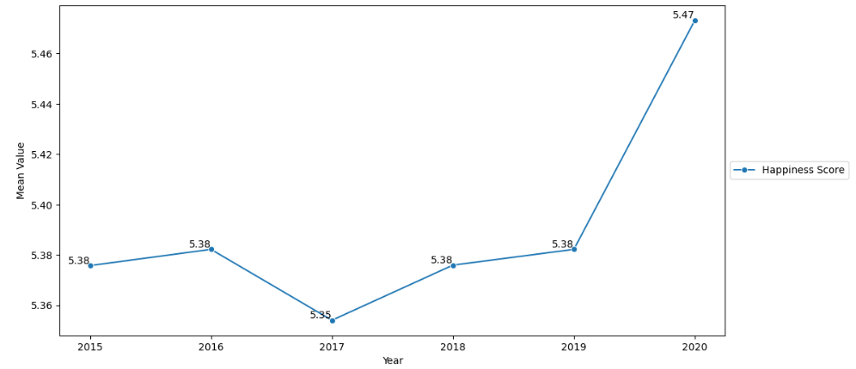
Happiness Scores over the years…
Happiness Score remained remarkably stable over the years 2015-2020, suggesting that it is influenced by a complex interplay of factors beyond just economic prosperity, social support etc.
Notes:
Happiness Score¶
So it’s most notable trend would be it’s stability. Looking at the line graph above the mean Happiness Score has remained relatively stable over the years, with slight fluctuations, mainly in the years 2019-2020 where a very small increase in the Happiness score can be seen.
This would suggest resilience to economic changes, robust social support and health, and cultural/societal factors which may help when the former factors fluctuate.
This stability emphasizes the resilience of overall happiness and the need for a holistic approach to improving well-being that goes beyond economic indicators.

Slide 6
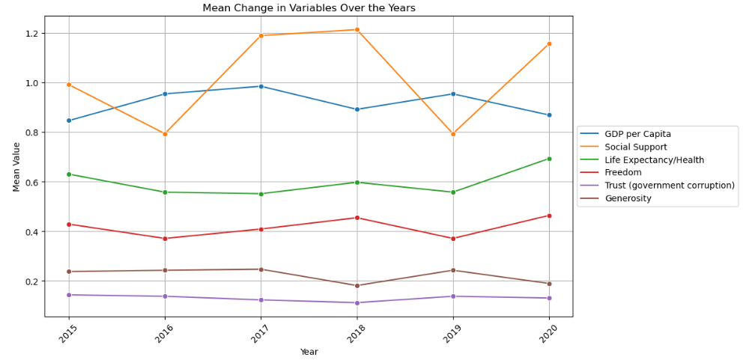
What about the other variables?
Notes:
GDP and social play a large part in happiness scores, followed by life expectancy. Lowest contributor is trust in government (suggesting it is low across the board)

Slide 7
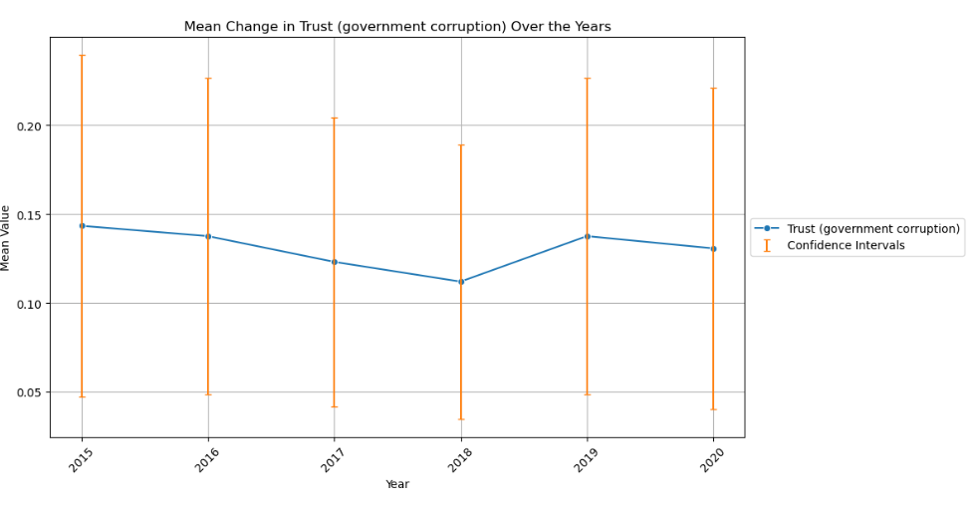
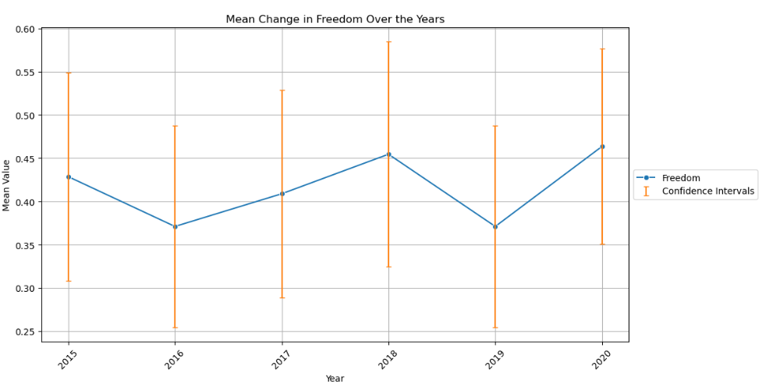
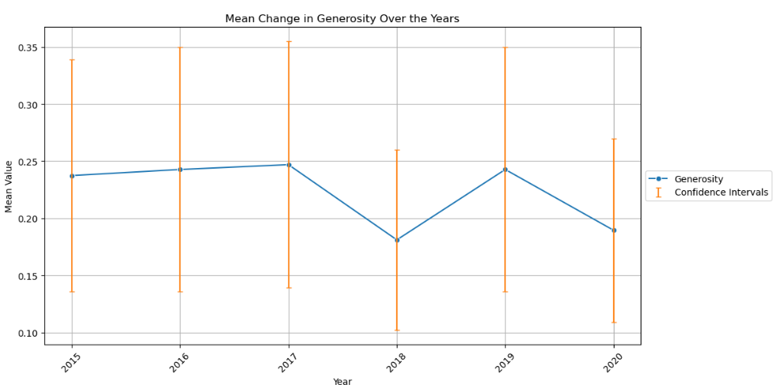
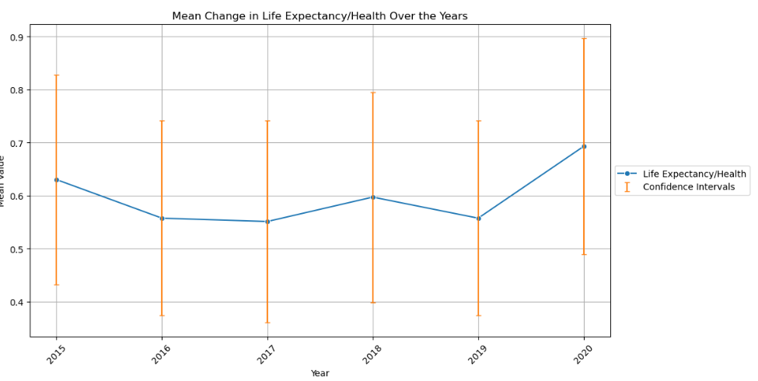
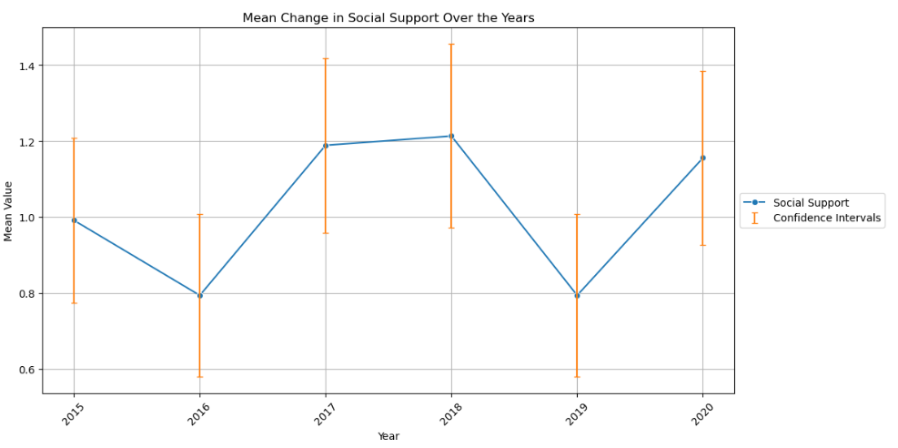
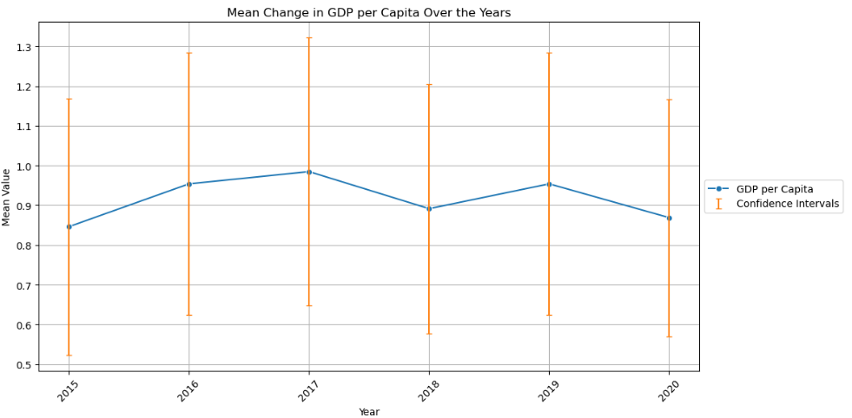
Is this significant?
Notes:
Overlapping confidence intervals here would suggest that the effects each variable has on happiness is interlinked and not owed to one single factor, such as economic prosperity. Therefore it would be important to address all the factors in a holistic approach to improve the well-being of a population.

Slide 8

How does GDP per Capita effect each variable in the World Happiness Report?

Slide 9
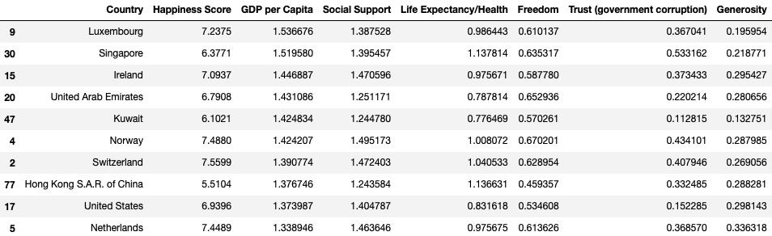
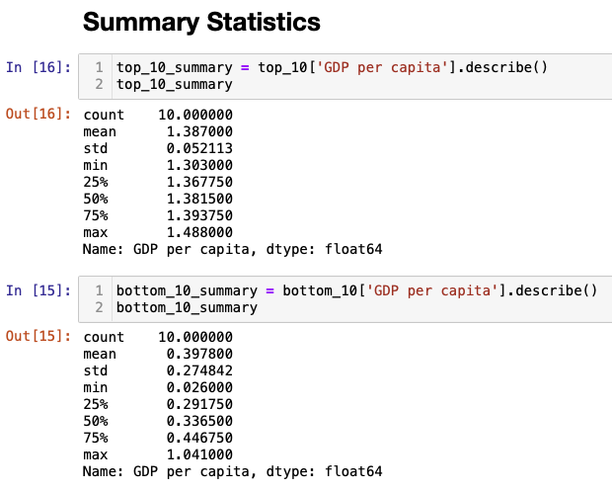
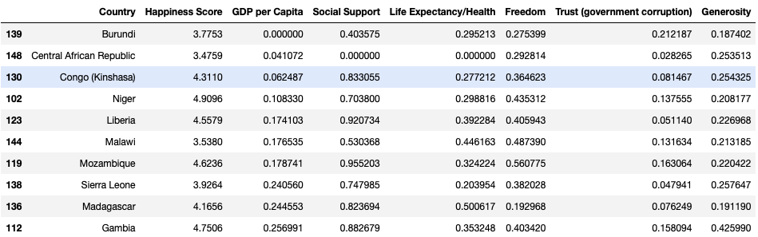
Top 10 & Bottom 10 Countries

Slide 10
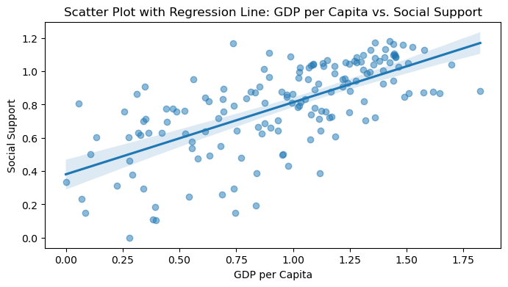
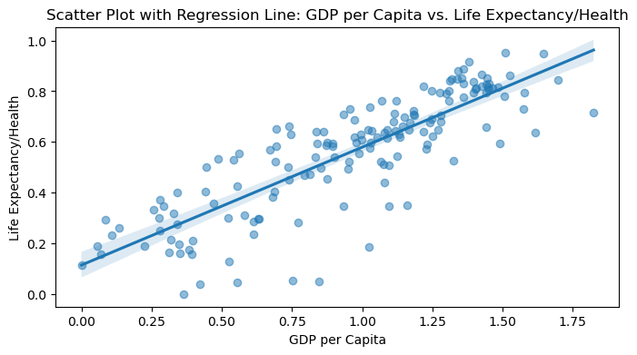
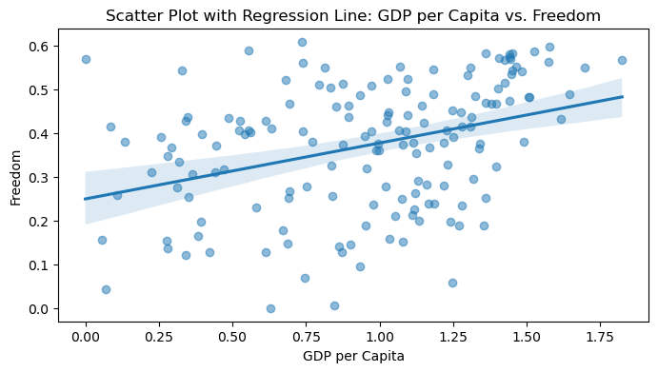
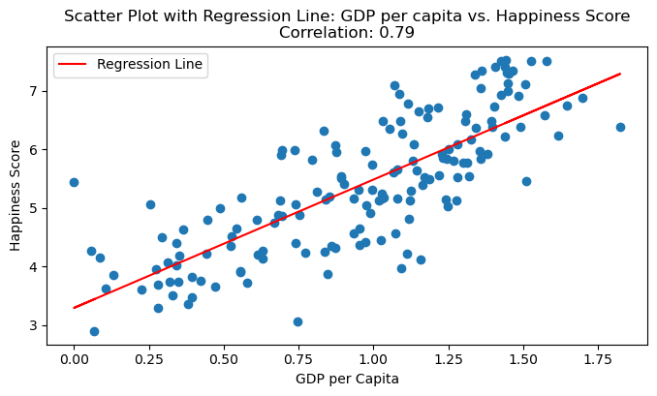
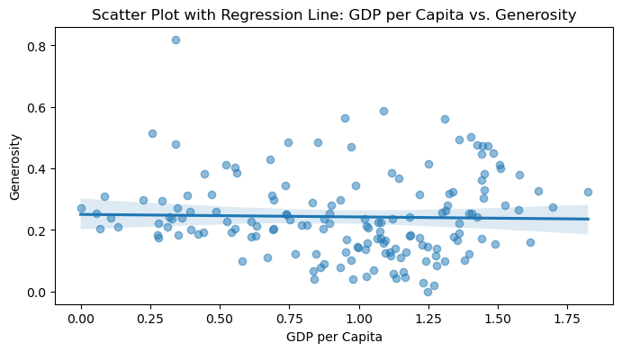
Scatter plot visual with regression line – showing GDP vs Happiness, GDP vs other attributes

Slide 11
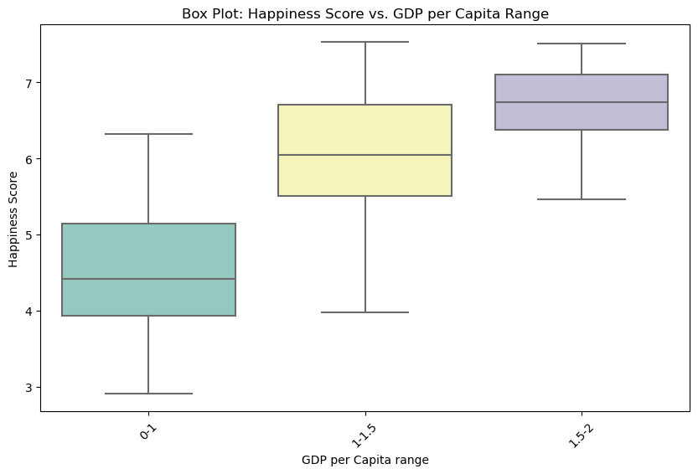
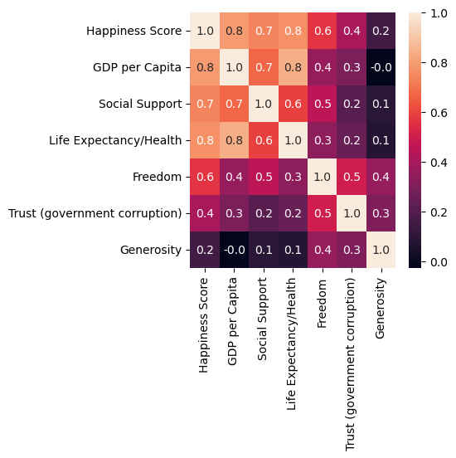
Box plot visual showing GDP variances in the lower plots vs higher plots

Slide 12

How do socio-cultural factors influence the various variables assessed in the World Happiness Report?

Slide 13
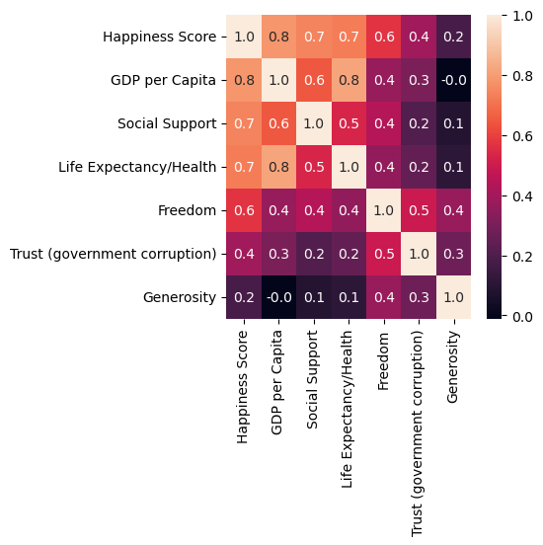
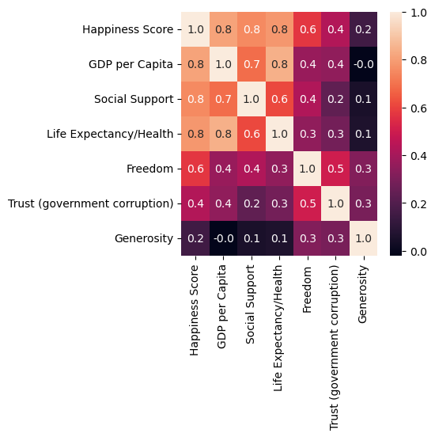
Correlation between different attributes on the heatmap/Correlation Map and comparison between different years:
Correlation between different attributes on the heatmap/Correlation Map and comparison between different years:
2015
2016
2017

Slide 14

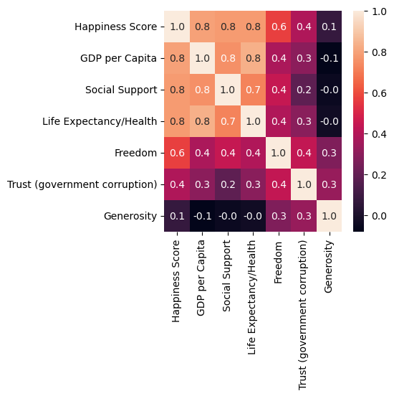
2018
2019

Slide 15

Correlation between different attributes:
Correlation between Happiness score and Social Support is strong with a coefficient of 0.7.
Correlation between GDP per Capita and Social Support is not strong with a coefficient of 0.5.
Correlation between Social Support and Life Expectancy/Health is week with a coefficient of 0.5.
Correlation between Social Support and Freedom is week with a coefficient of 0.4.
Correlation between Social Support and Trust(Government Corruption) is week with a coefficient of 0.3.
Correlation between Social Support and Generosity is week with a coefficient of 0.1.

Slide 16
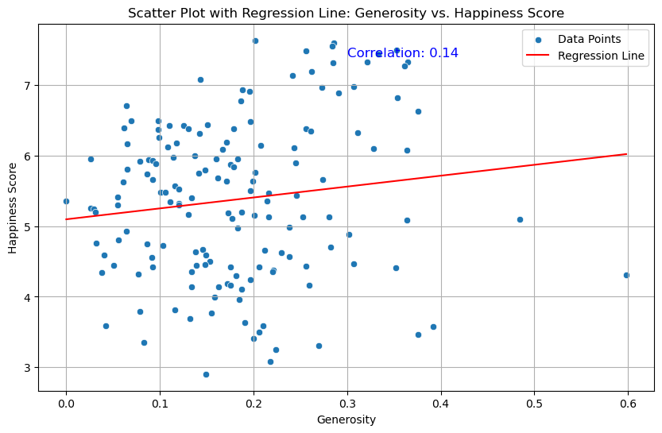
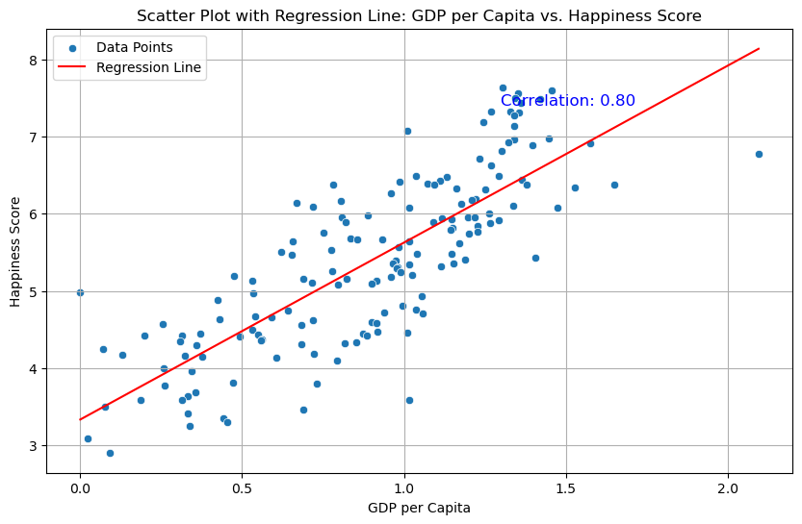
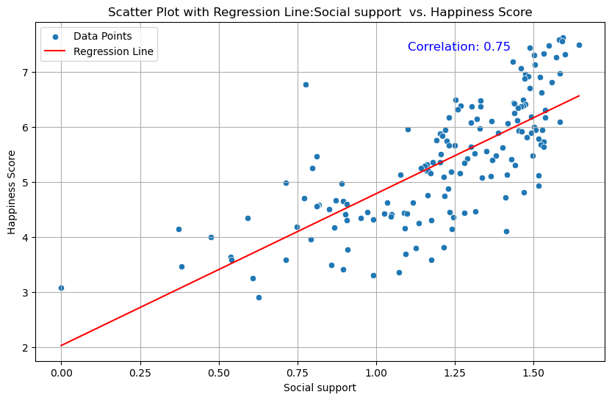
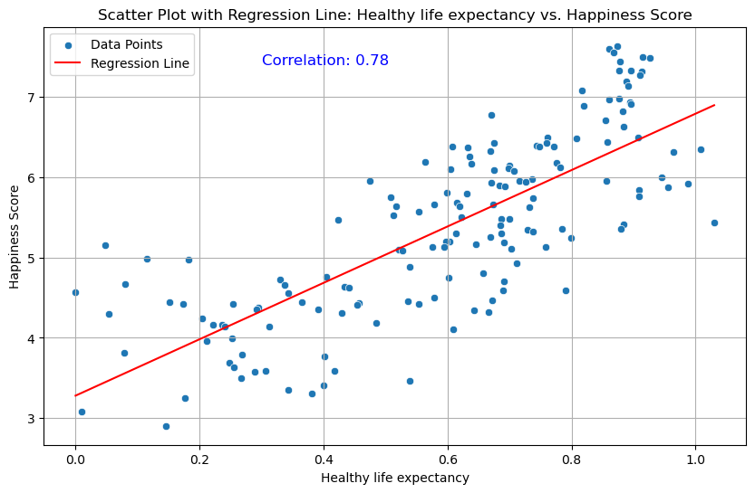
Scatter Plot with regression line:

Slide 17
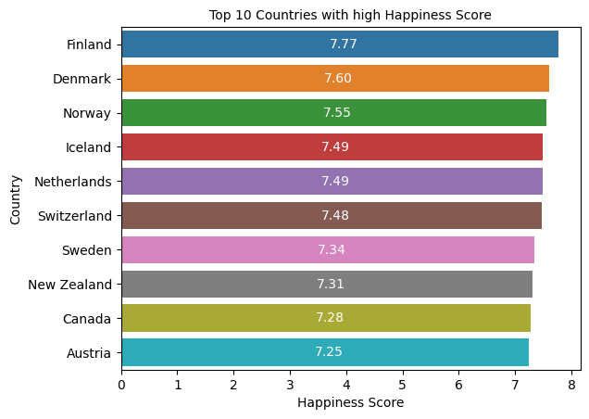
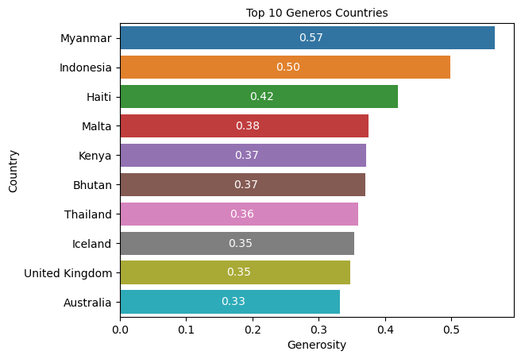
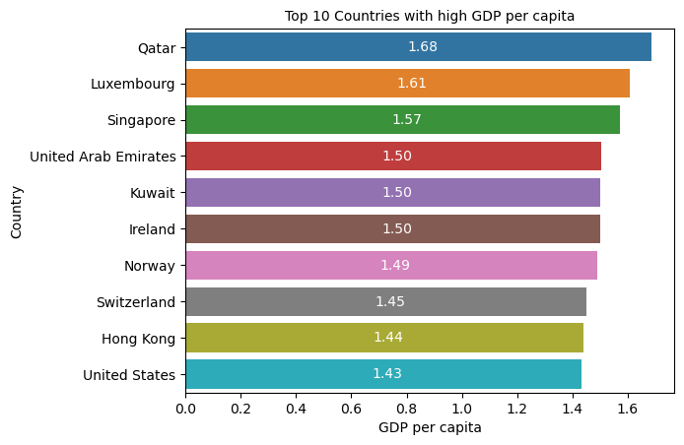
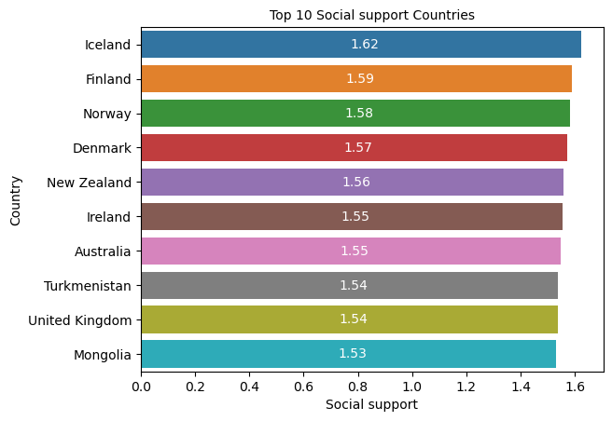
Bar plot comparison of different attributes for the top 10 countries:

Slide 18
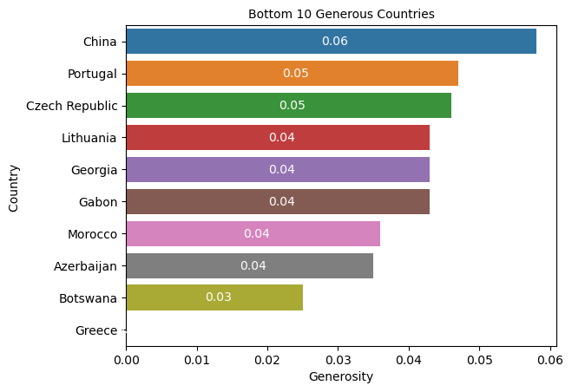
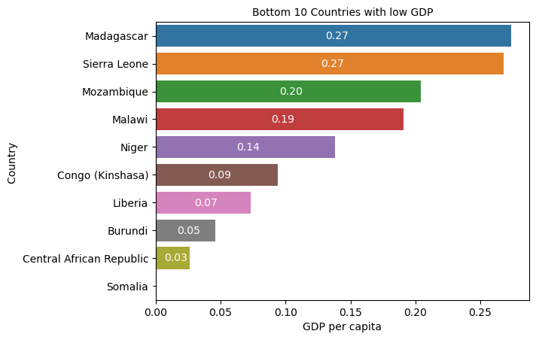
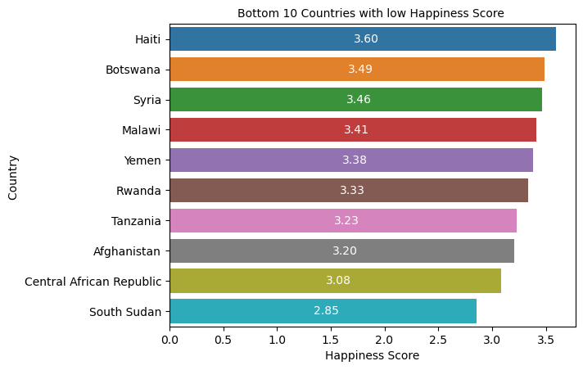
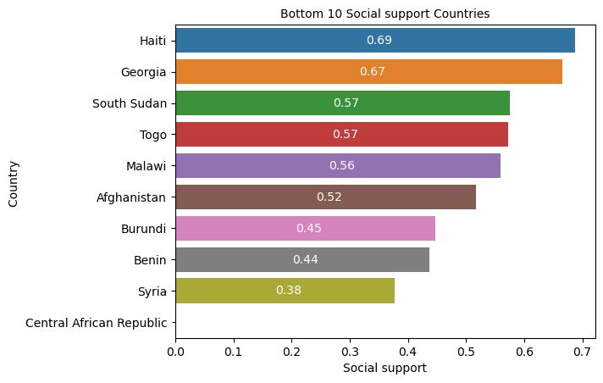
Bar plot comparison of different attributes for the bottom 10 countries:

Slide 19

How did these factors evolve in response to the unique challenges posed by the COVID-19 pandemic in 2020?

Slide 20
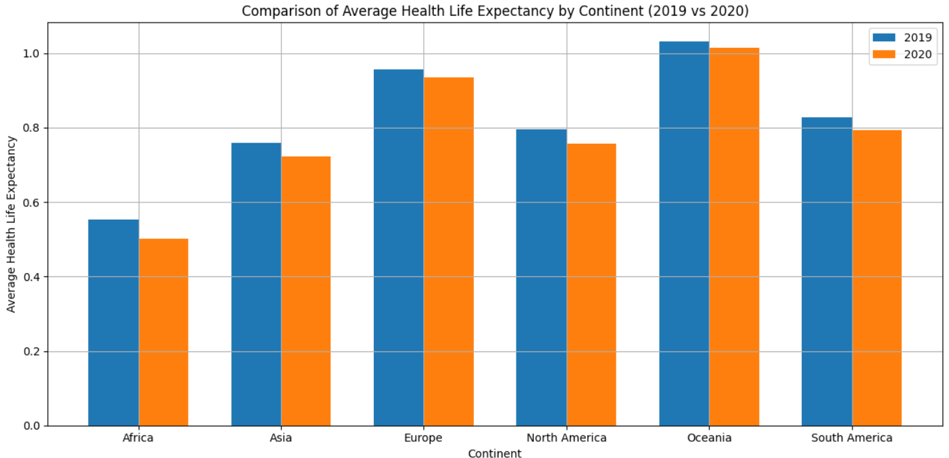
The analysis reveals a notable decrease in health life expectancy across continents from 2019 to 2020. Oceania and Europe maintained relatively stable levels, while Asia showed a moderate decrease.

Slide 21
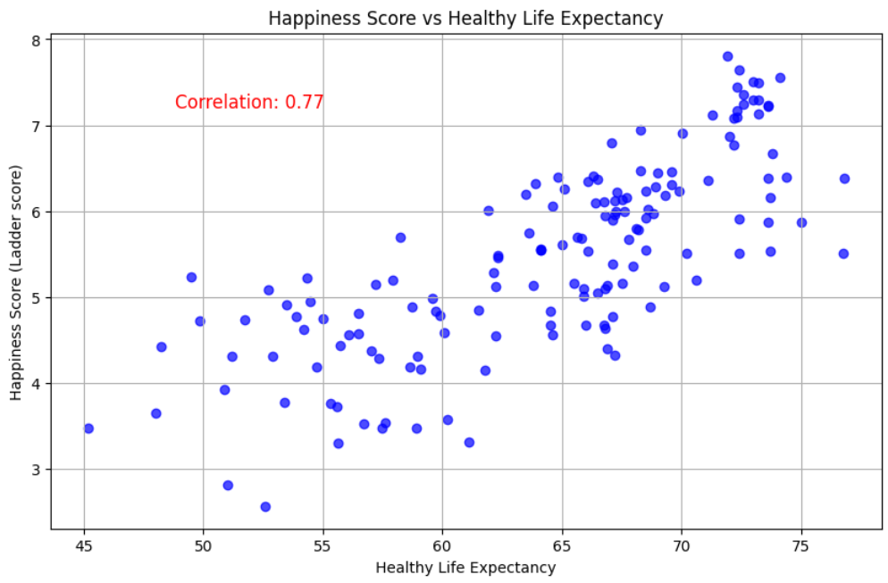
Scatter plot of Happiness vs. Life Expectancy in 2020
A moderate negative correlation between life expectancy and COVID-19 cases.
Countries with higher life expectancy tend to have fewer COVID-19 cases on average.

Slide 22
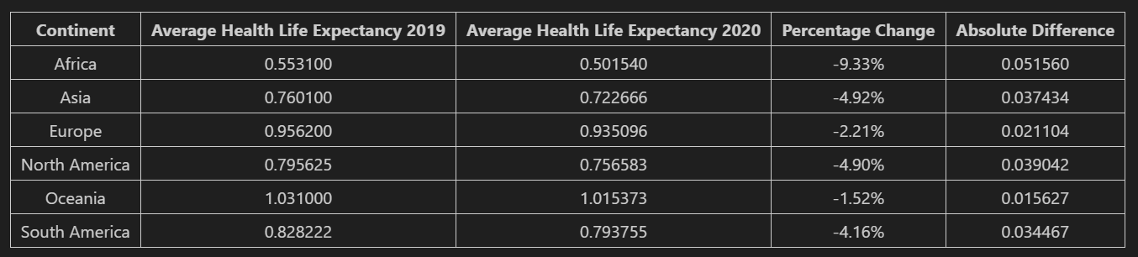
Africa experienced the most significant reduction (-9.33%)

Slide 23
"In this analysis, we explored the shifts in average health life expectancy across continents from 2019 to 2020. The data reveals a concerning trend, with decreases seen in every continent. Africa experienced the most significant dip at 9.33%, indicating potential health challenges or socioeconomic impacts. South America and North America followed suit with declines of 4.16% and 4.90%, respectively. Europe and Asia also saw reductions, while Oceania displayed a more moderate decrease at 1.52%. These changes shed light on the collective health struggles faced globally during the pandemic, urging us to focus on healthcare and societal support to improve these vital indicators in the future."

Slide 24

Conclusion
Globally, GDP tends to have a stronger positive correlation with various attributes, with a relatively weaker impact observed in the least happy countries.
Social/cultural factors have a strong correlation with other attributes in the majority of countries
Countries with higher life expectancy tend to have fewer COVID-19 cases on average.
Overall GDP has positive correlations with most attributes, although it has a lower impact in the bottom happiest countries.

